Slide 1
Final - Review

Slide 2
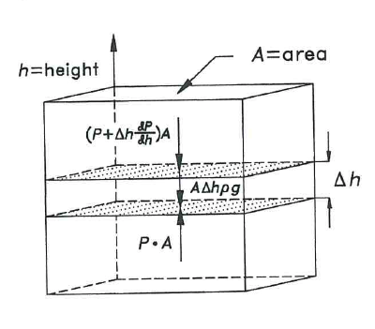
Pressure in Atmosphere

Slide 3
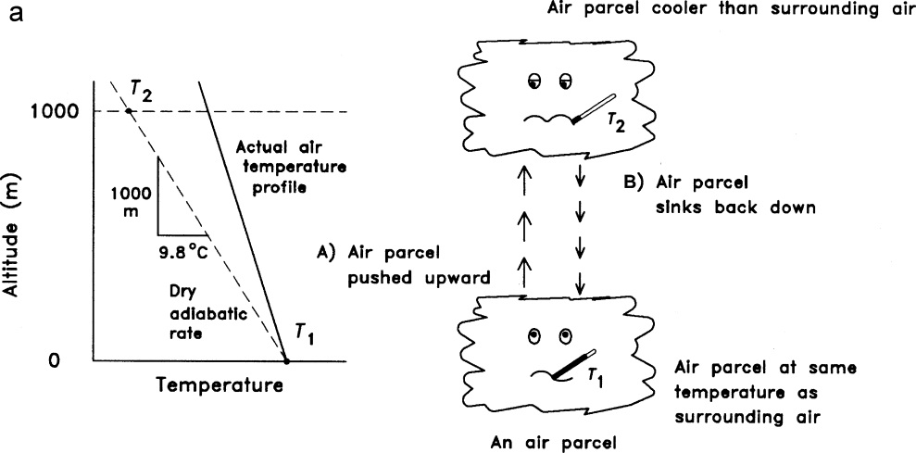
Stability and Lapse Rates

Slide 4
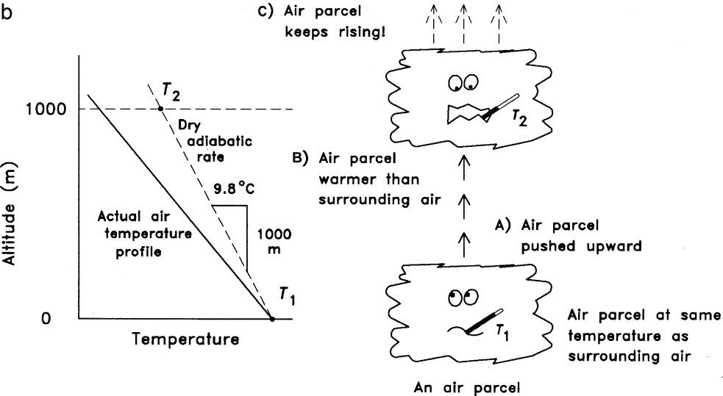
Stability and lapse rates

Slide 5
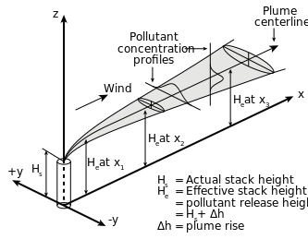
Gaussians

Slide 6
Gaussians
Buoyancy Flux
T – Temperature
s – stack
a – ambient
d – diameter
V – stack gas velocity

Slide 7
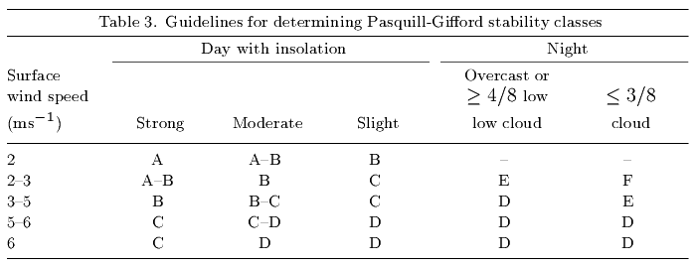
What about spreading σ_{y} and σ_{z}
Depends on Condition – Wind & Insolation

Slide 8
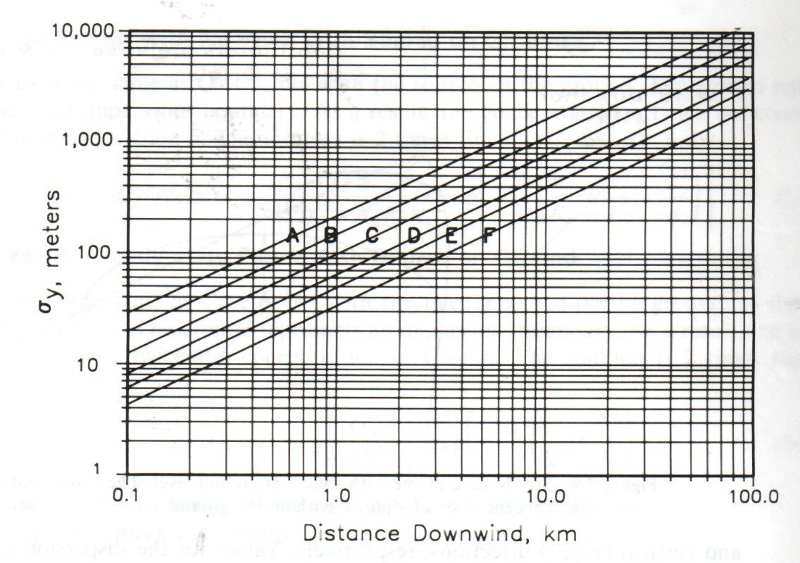
Pasquill-Gifford - Look it up…

Slide 9
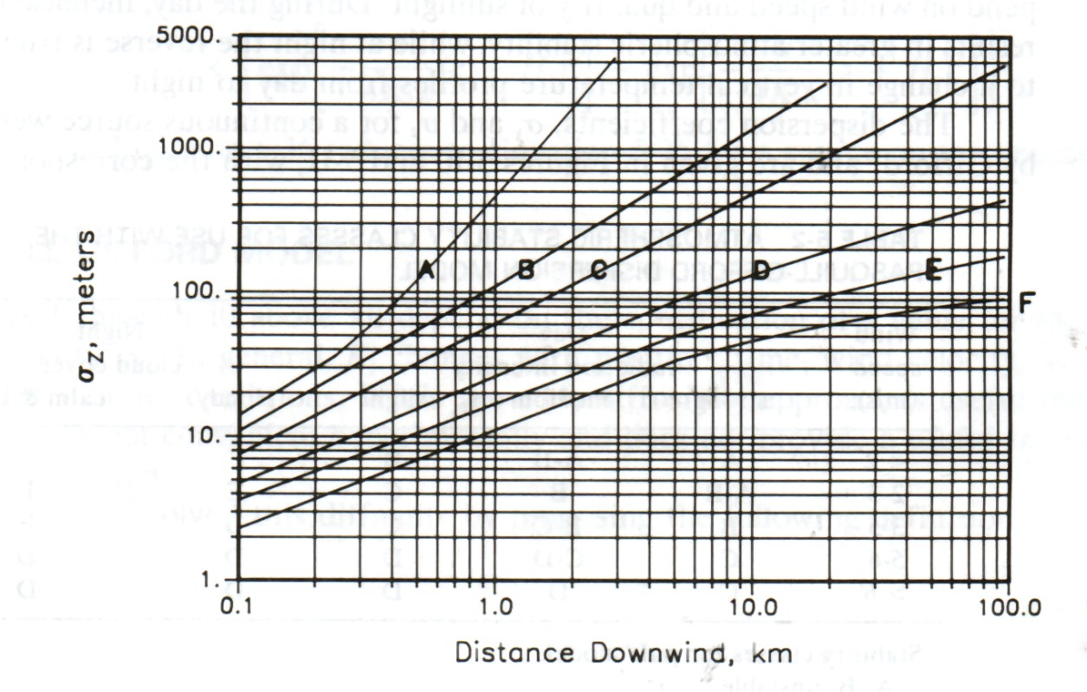
Pasquill-Gifford - Look it up…

Slide 10
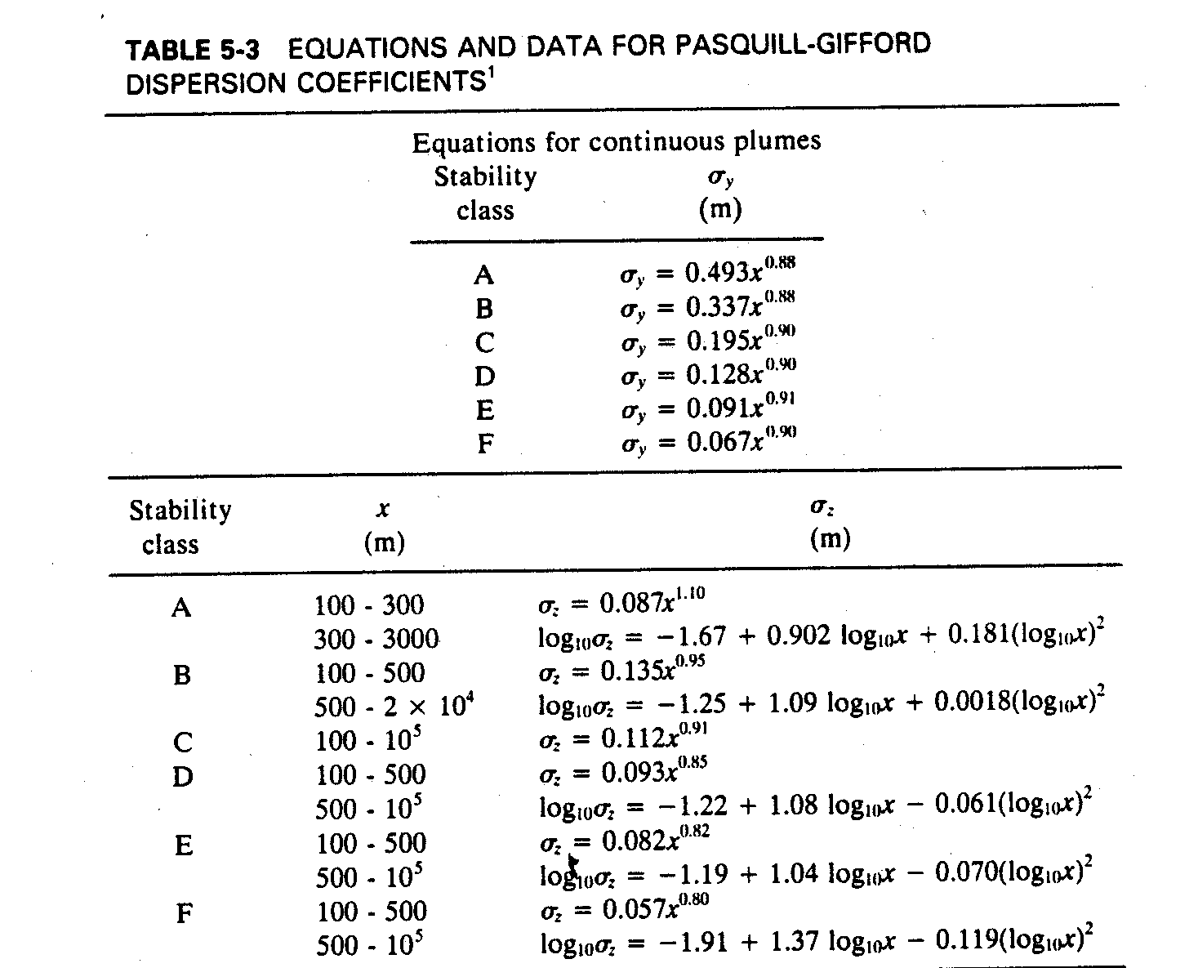
OR

Slide 11
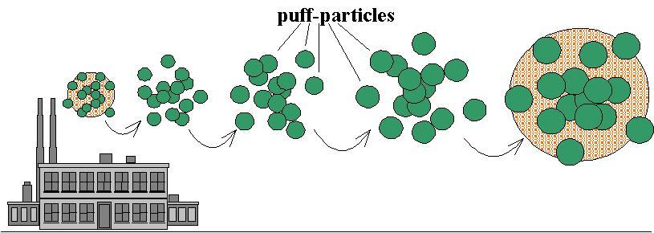
The Puff Model

Slide 12
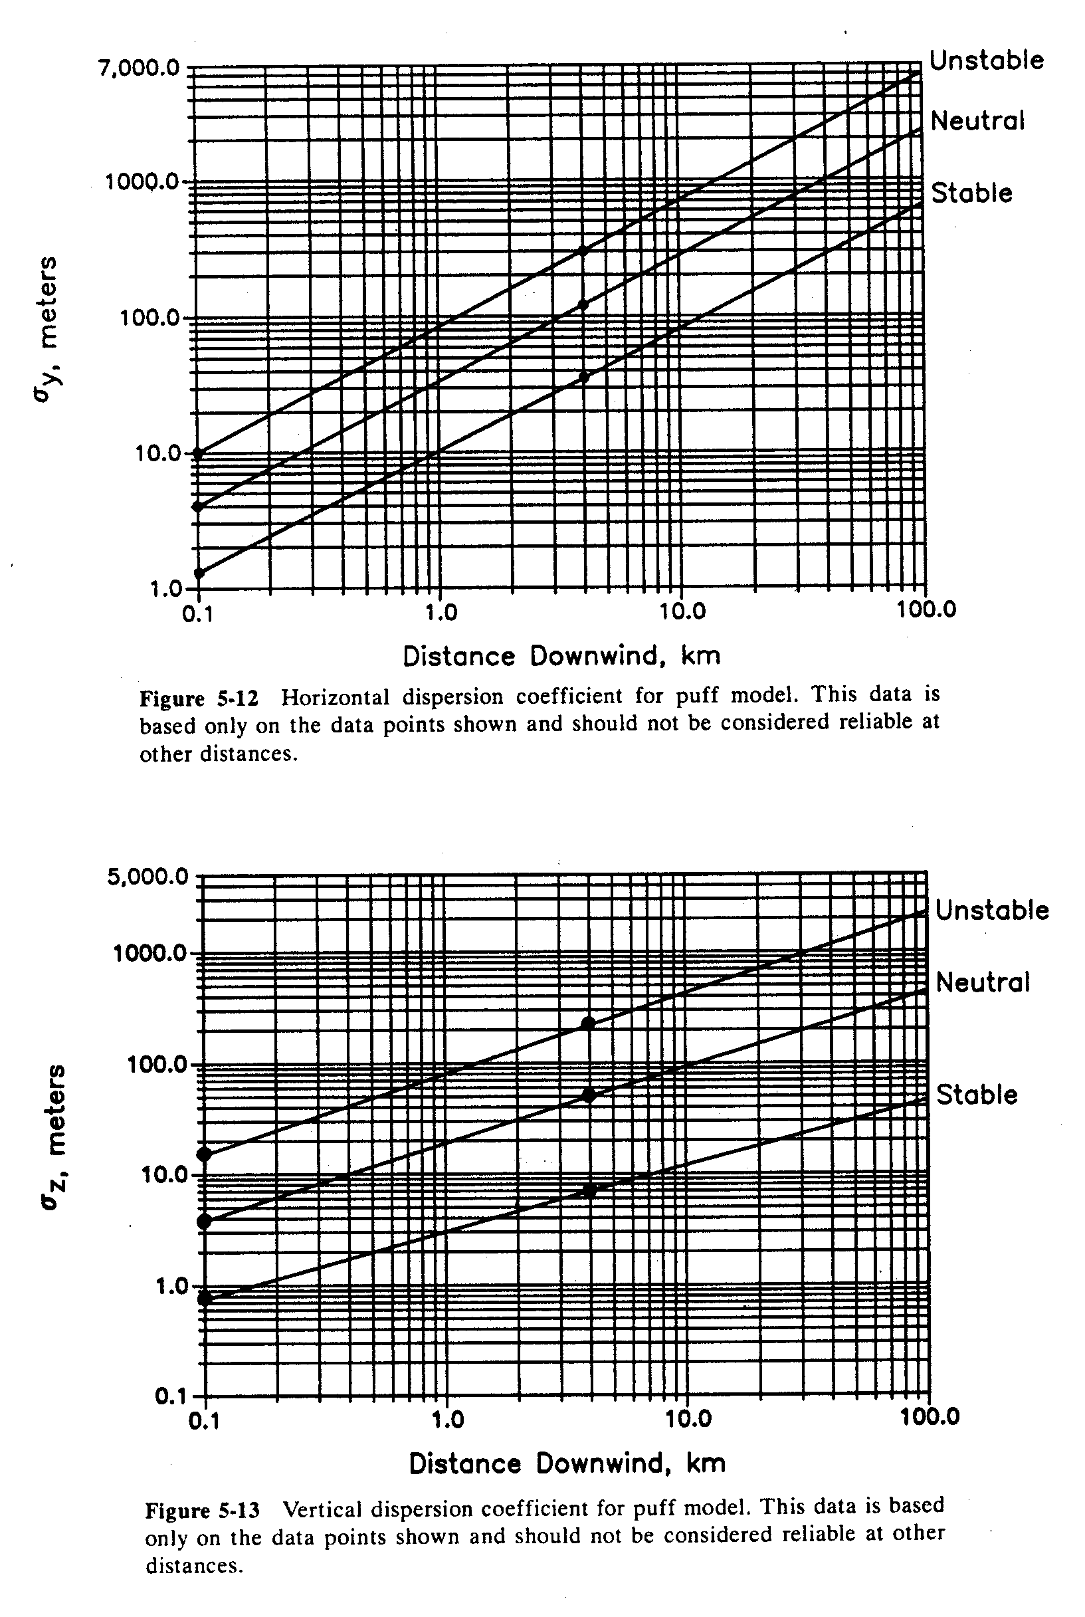
Puff Model Dispersion

Slide 13
Indoor Air

Slide 14
Traditional Model

Slide 15
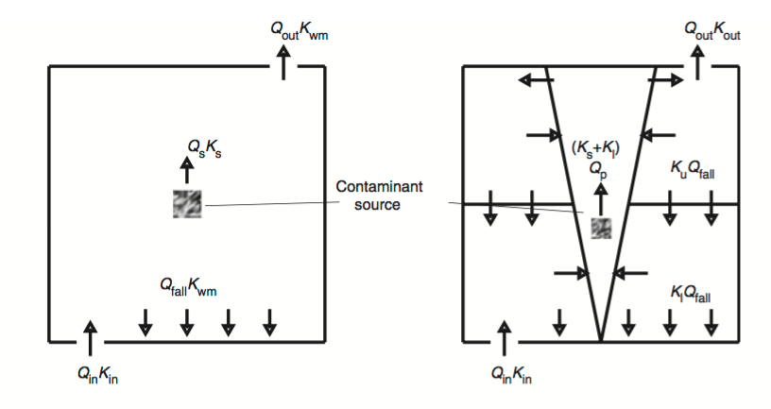
Conceptual Models

Slide 16
Steady State
Well Mixed
Displacement

Slide 17
Steady State – Divide by Q_{in}
Well Mixed
Displacement
So which is better?

Slide 18



Steady State - Step Up (K_{in}=1,K_{s}=0)
Well Mixed
Displacement
Implications
Bad News
for Low
Energy!

Slide 19


Steady State – Point (K_{in}=0,K_{s}=1)
Well Mixed
Displacement
Implications
Good News!

